Slide 1



Build Interactive Web App with R & Shiny
Prepared by : Aep Hidayatuloh
Email : aephidayatuloh.mail@gmail.com
GitHub : https://github.com/aephidayatuloh
RPubs : https://rpubs.com/aephidayatuloh

Slide 2

Syllabus
Pertemuan | Kompetensi Dasar | Materi
3 | Mengenal interaktivitas dan menggunakannya di aplikasi shiny | Reactivity
 |  | observe()
 |  | observeEvent()
 |  | reactive()
 |  | eventReactive()
 |  | req() & isolate()
 |  | Update input widgets

Slide 3
Reactivity
In Shiny, you express your server logic using reactive programming

Slide 4
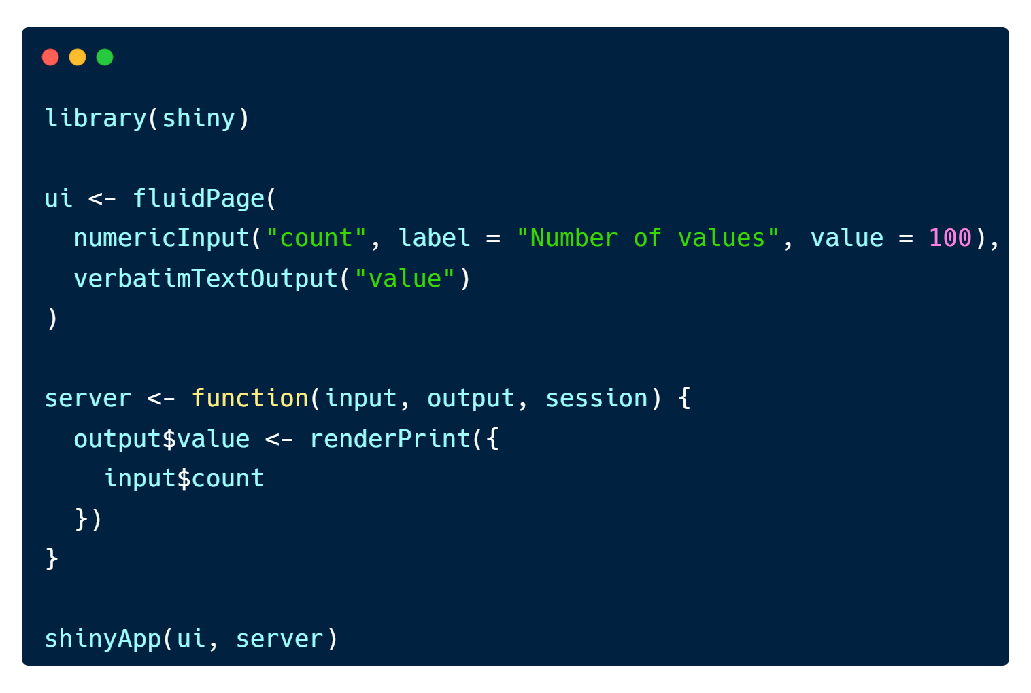
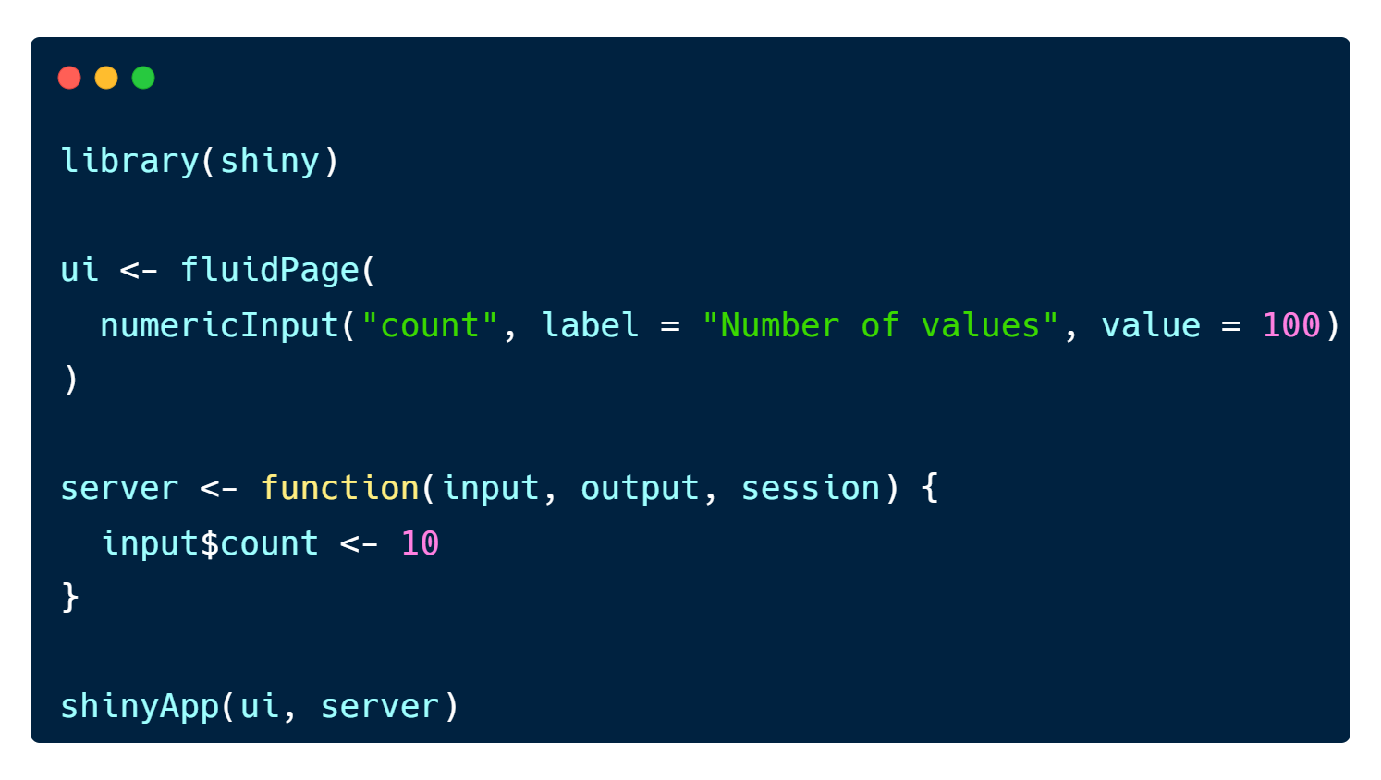


What does each app do?
Error in $<-: Can't modify read-only reactive value 'count'

Slide 5
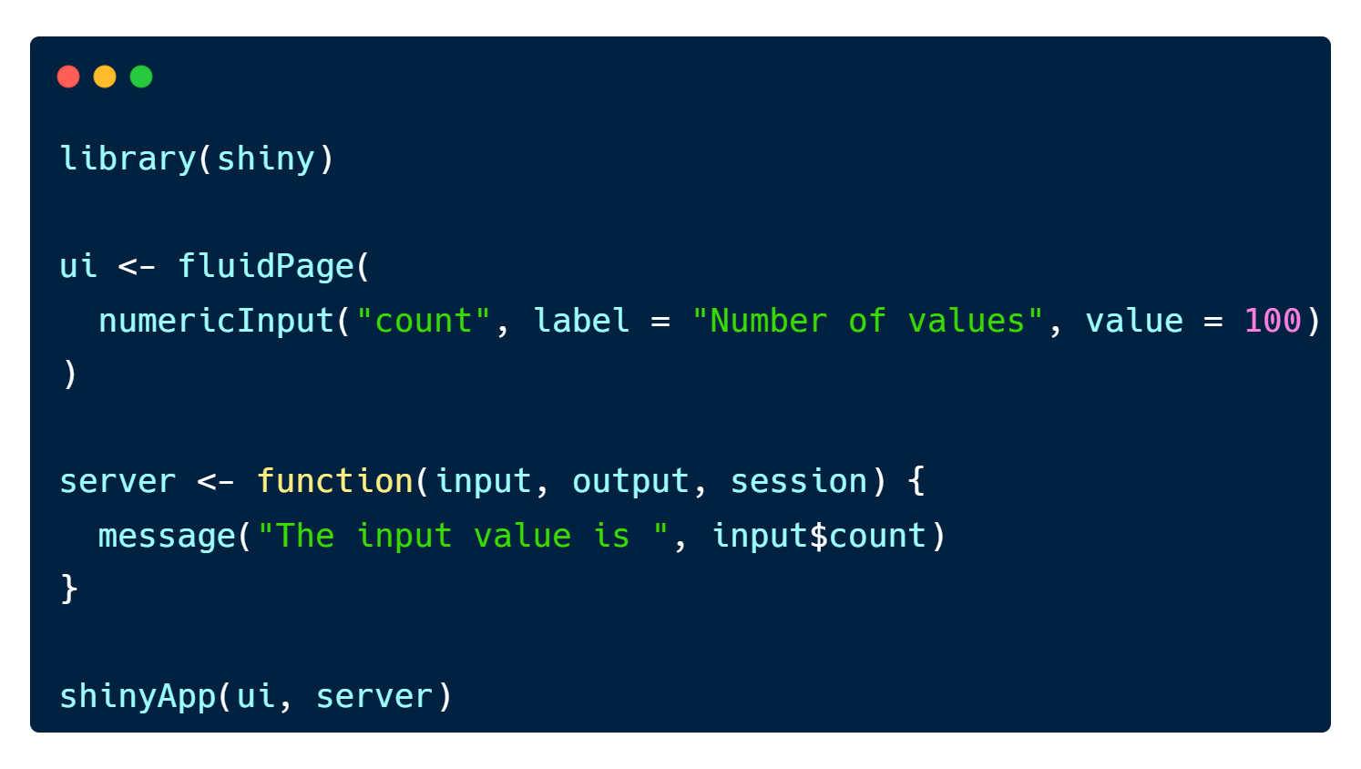
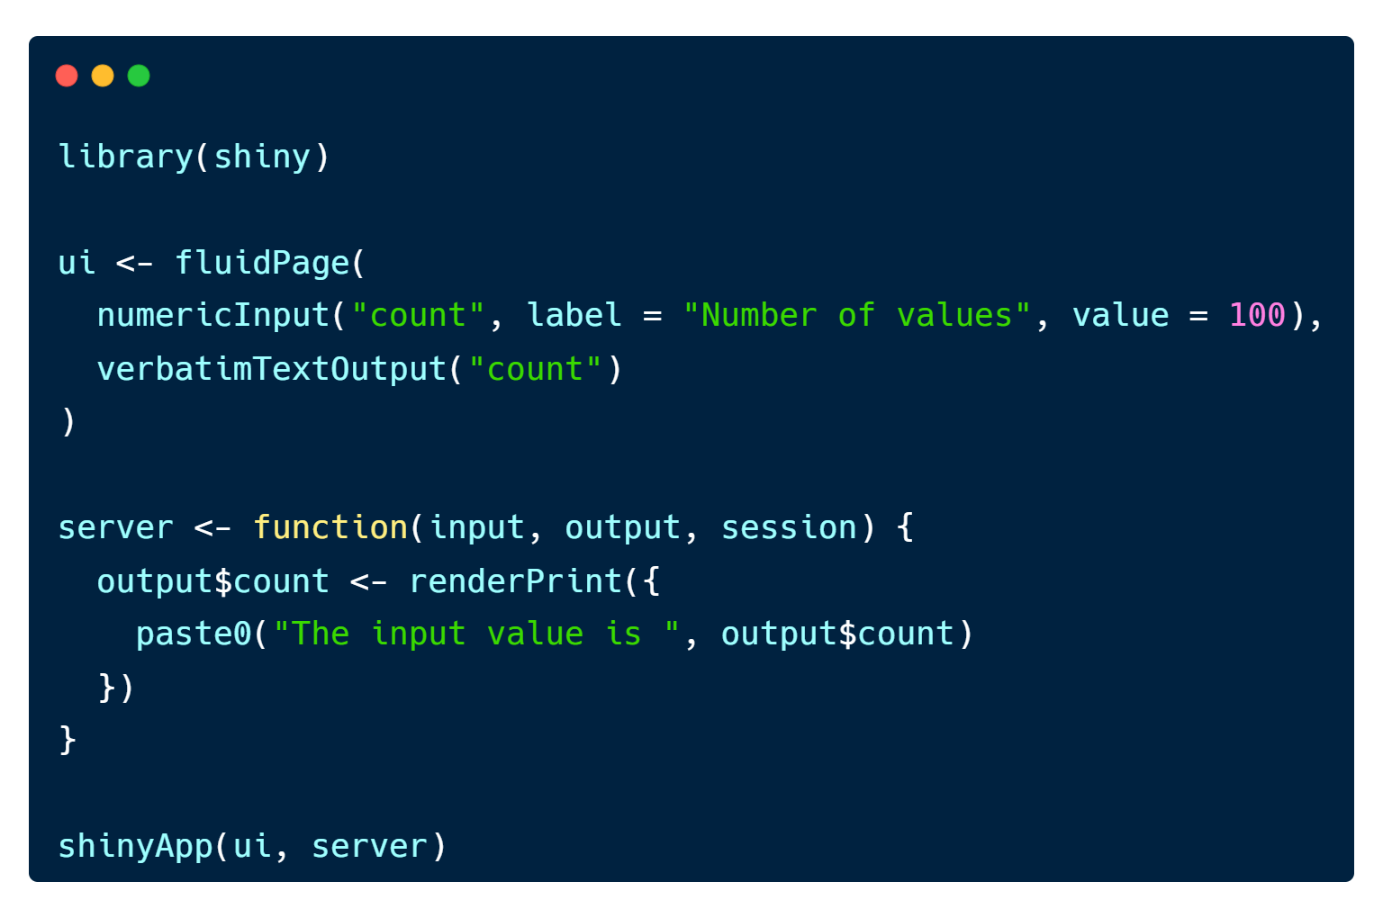
What does each app do?
Error in input$count :
Can't access reactive value 'count' outside of reactive consumer.
ℹ Do you need to wrap inside reactive() or observe()?
Error in $: Can't read output 'count'

Slide 6


What does each app do?

Slide 7
Reactivity
::Big idea in Shiny app::
You don’t need to tell an output when to update, shiny do it automatically!

Slide 8
Reactivity
Reactive Source
(input)
Reactive Endpoint
(output)
Reactive Graph

Slide 9
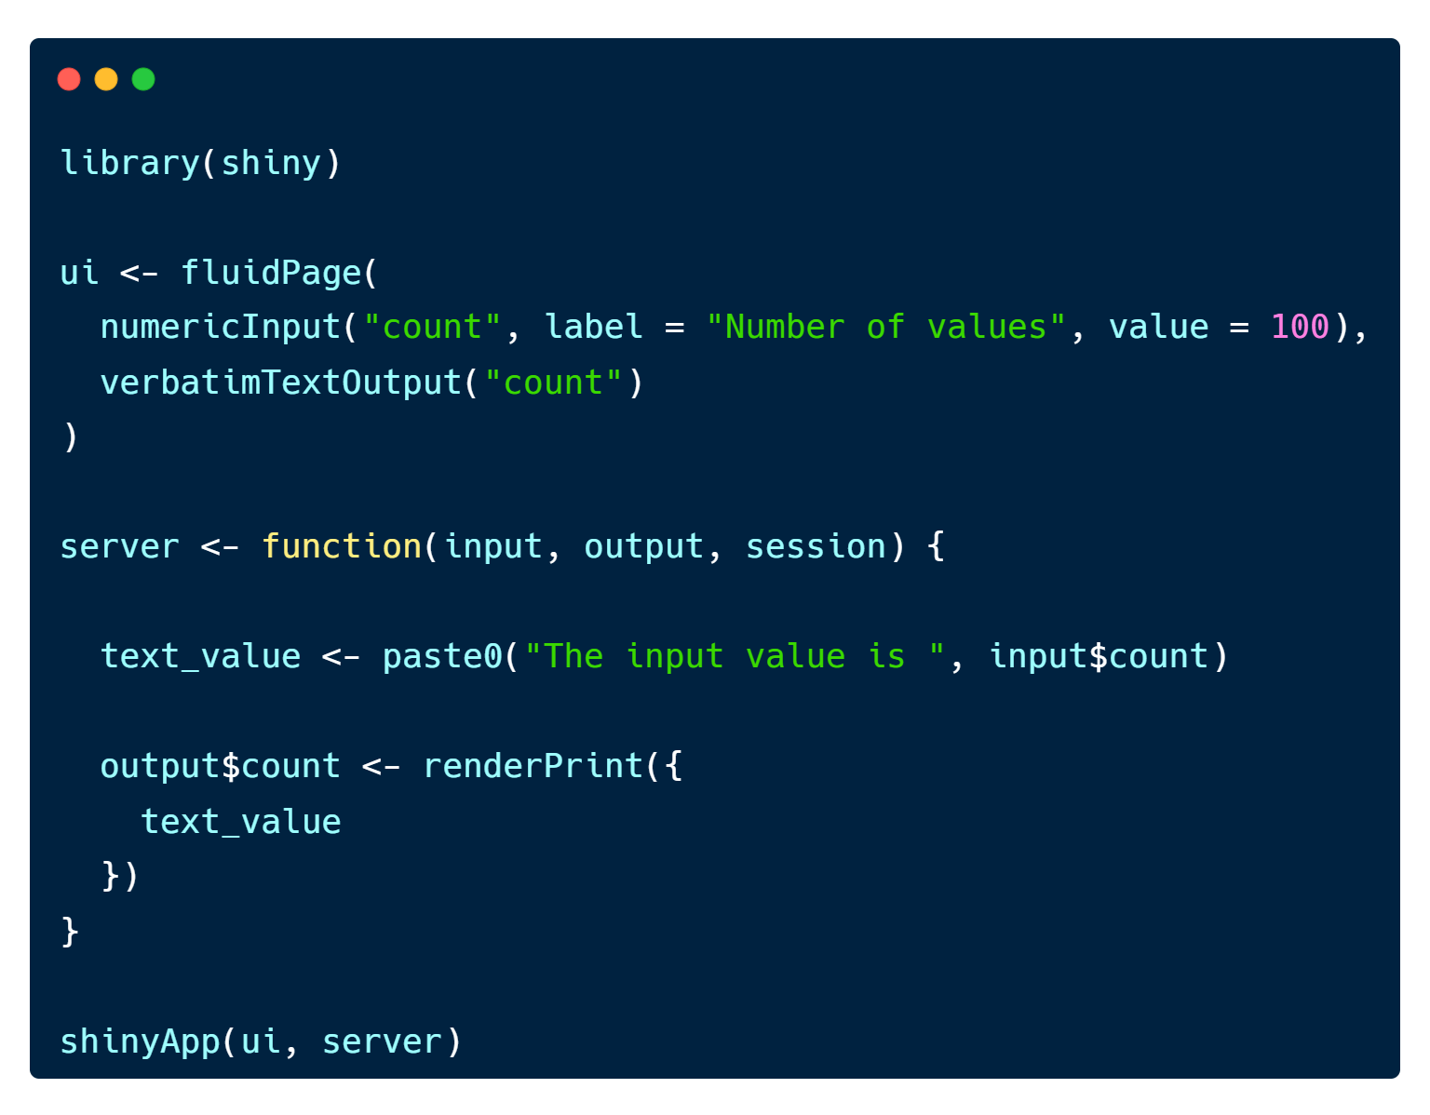
Reactivity
Error in input$count :
Can't access reactive value 'count' outside of reactive consumer.
ℹ Do you need to wrap inside reactive() or observe()?

Slide 10
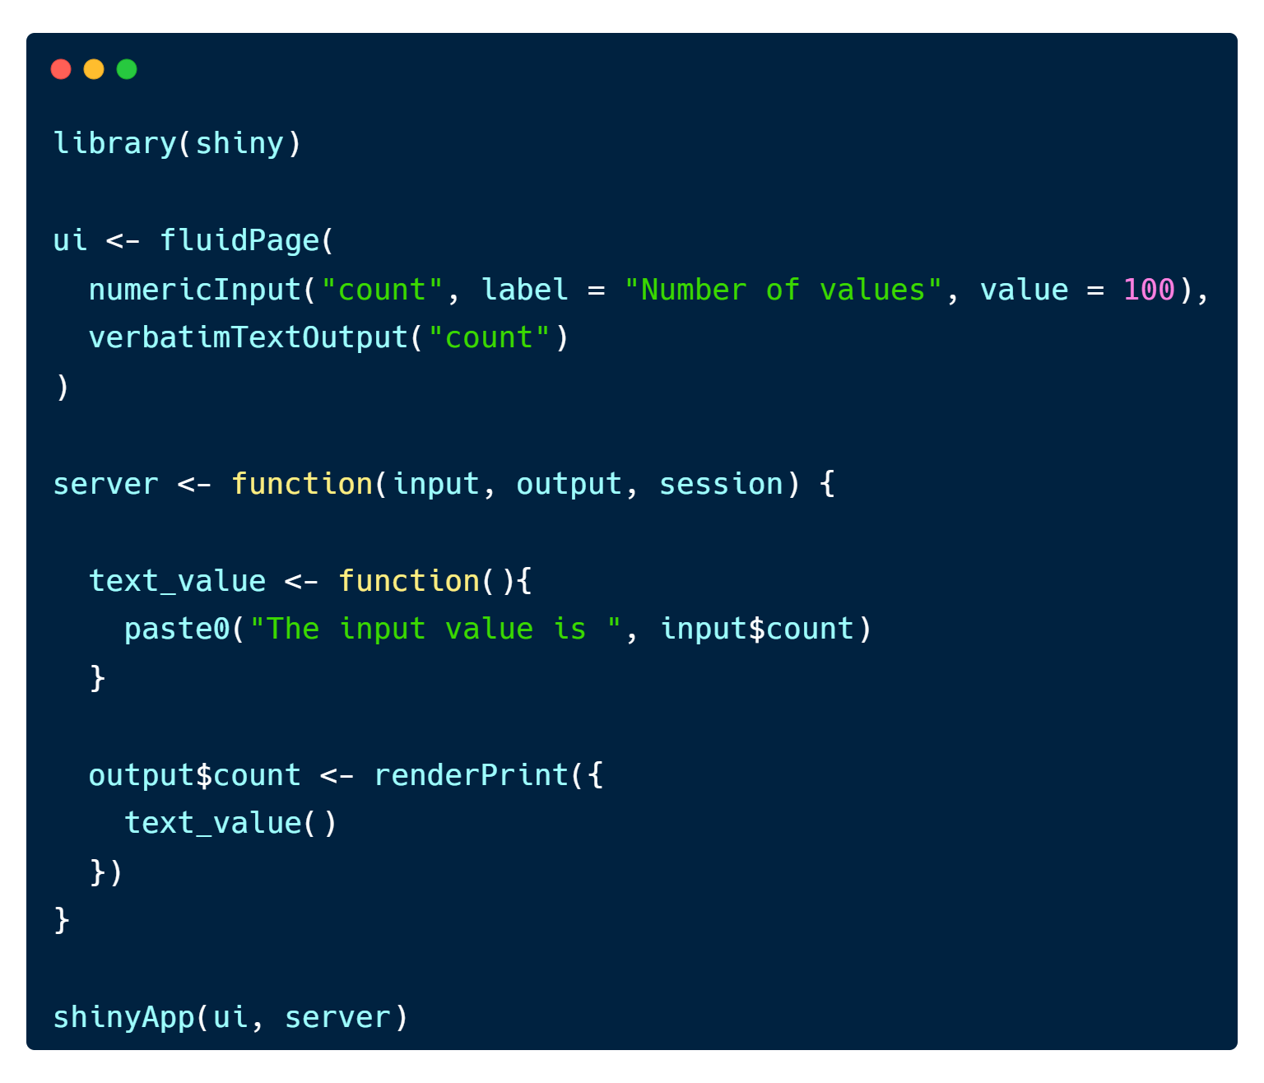
Reactivity
Reactive Source
(input)
Reactive Conductor
(intermediary)
Reactive Graph
Reactive Endpoint
(output)

Slide 11
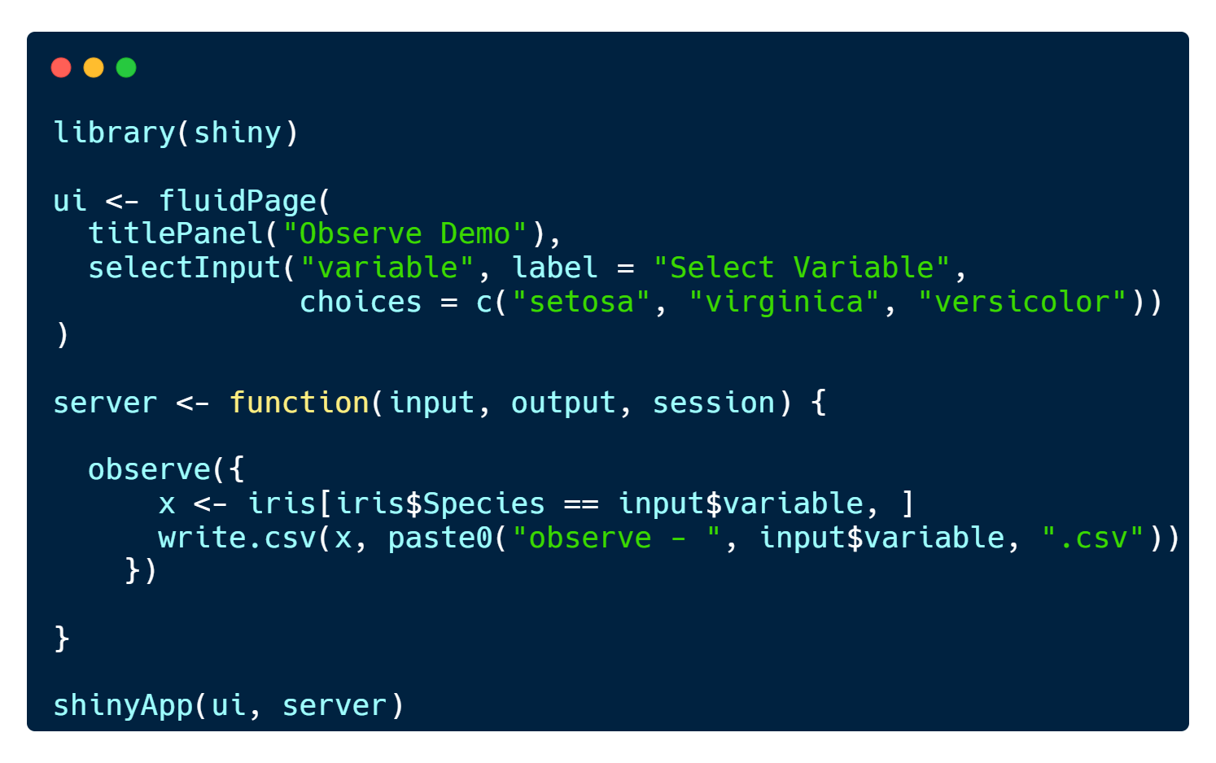
The observe()
observe(x, env = parent.frame(), quoted = FALSE, ..., label = NULL,
suspended = FALSE, priority = 0, domain = getDefaultReactiveDomain(), autoDestroy = TRUE, ..stacktraceon = TRUE)
# server
observe({…})
observe() -> Reactive environment if doesn’t need output

Slide 12
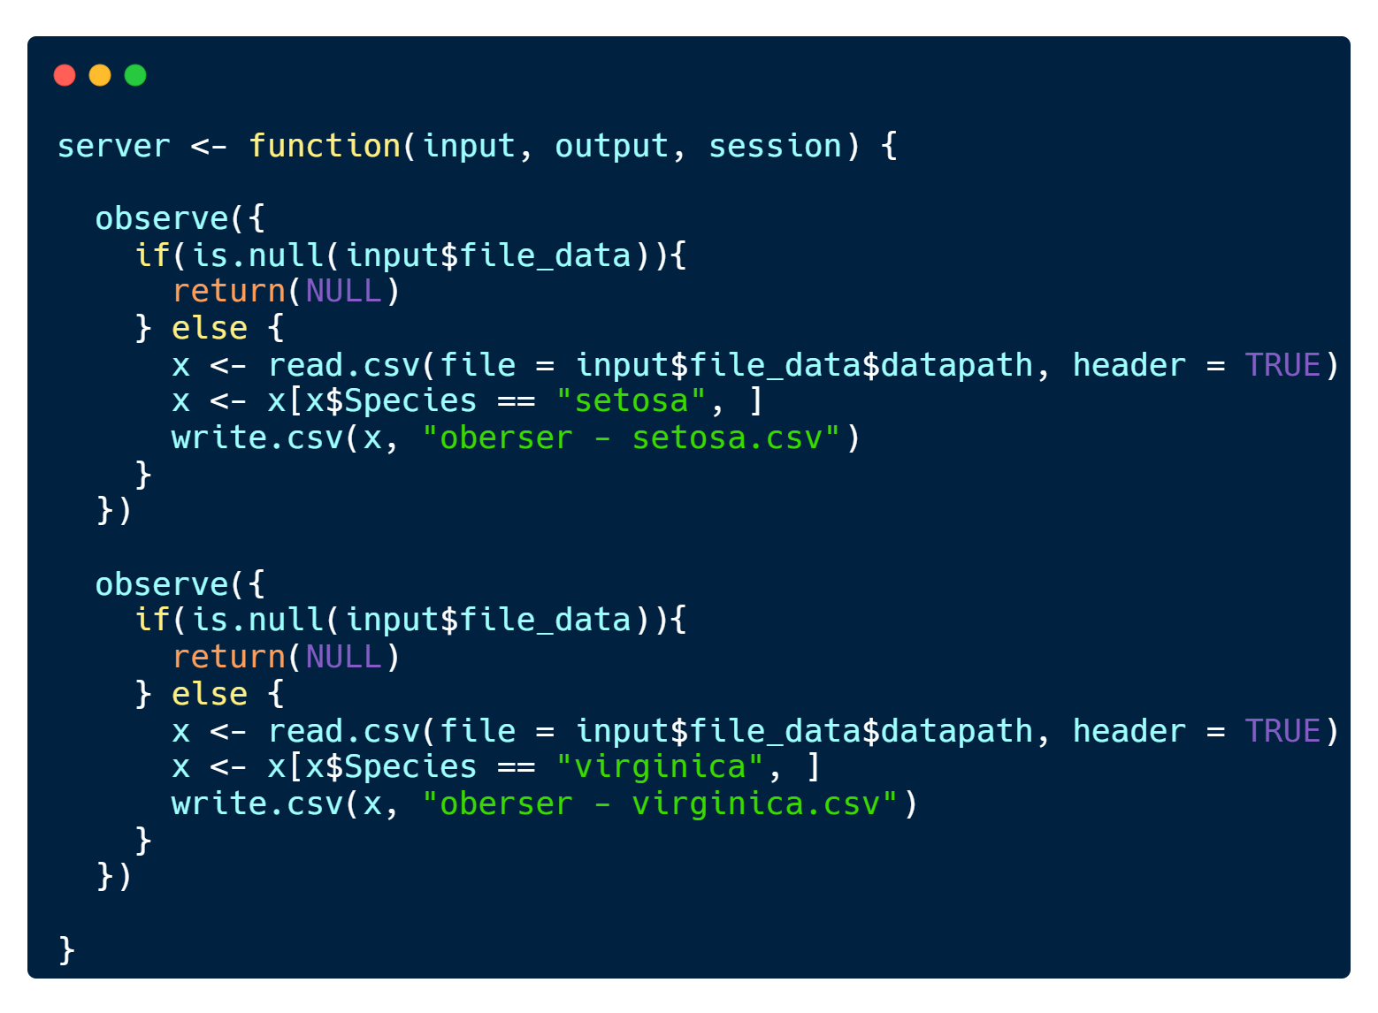
The observe()

Slide 13
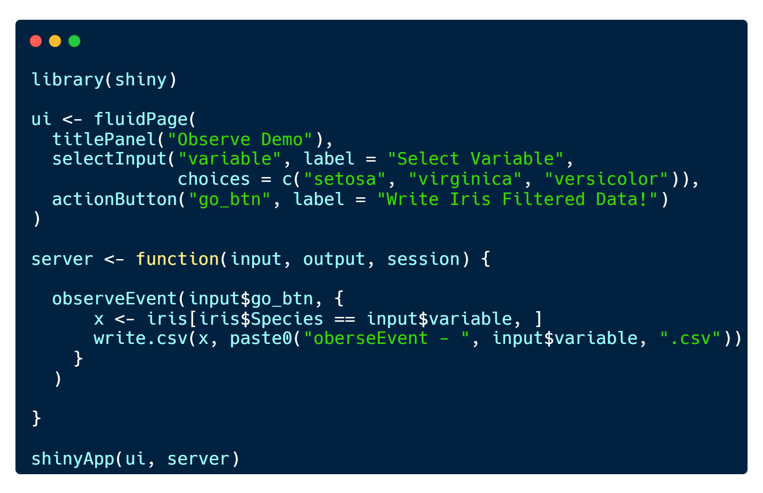
The observeEvent()
# server
observeEvent({…})
observeEvent() -> Reactive environment triggered event and doesn’t need output

Slide 14
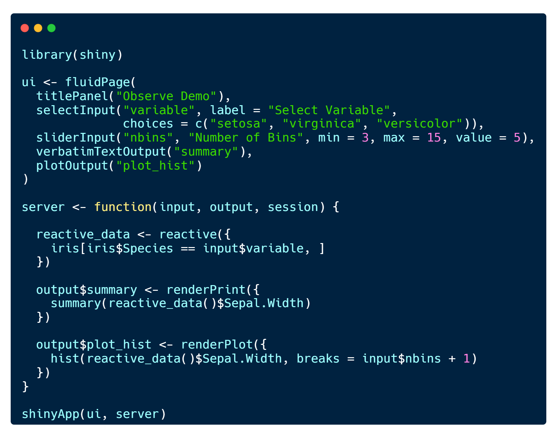
The reactive()
# server
<reactive_name> <- reactive({…})
# call inside server
<reactive_name>()
reactive() -> Reactive environment if need output of process

Slide 15
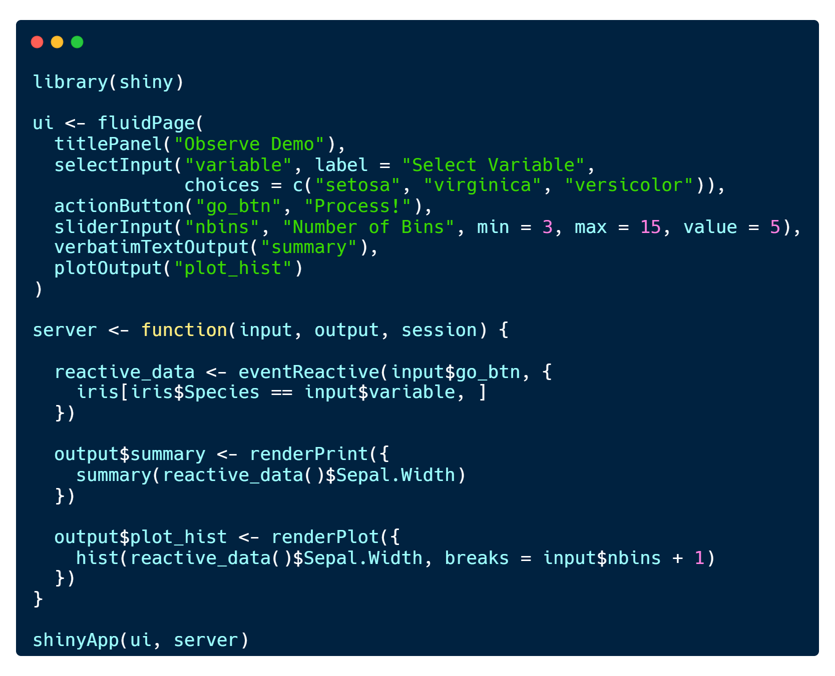
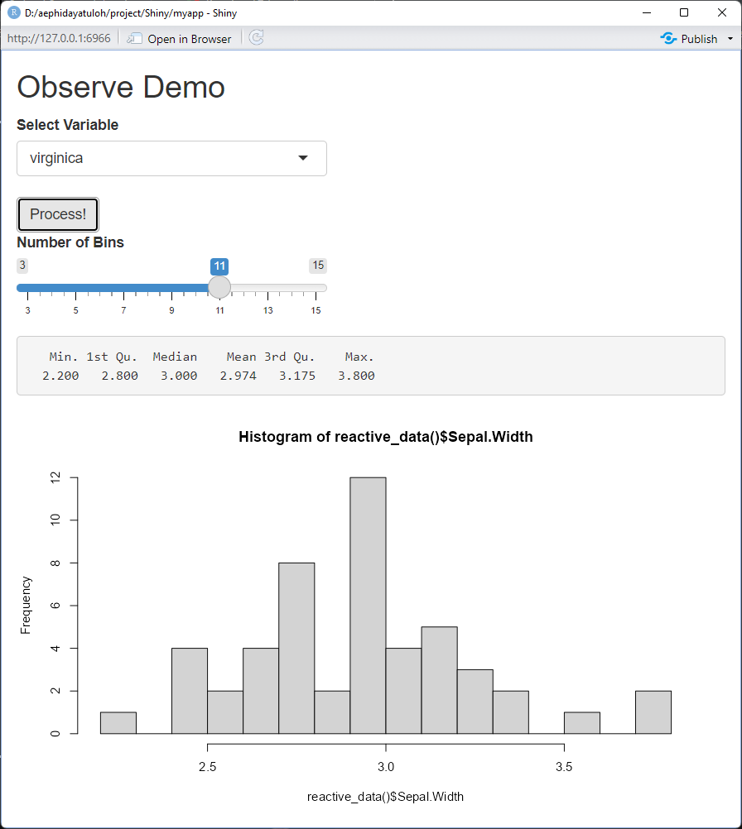
eventReactive()
# server
<reactive_name> <- eventReactive({…})
# call inside server
<reactive_name>()

Slide 16
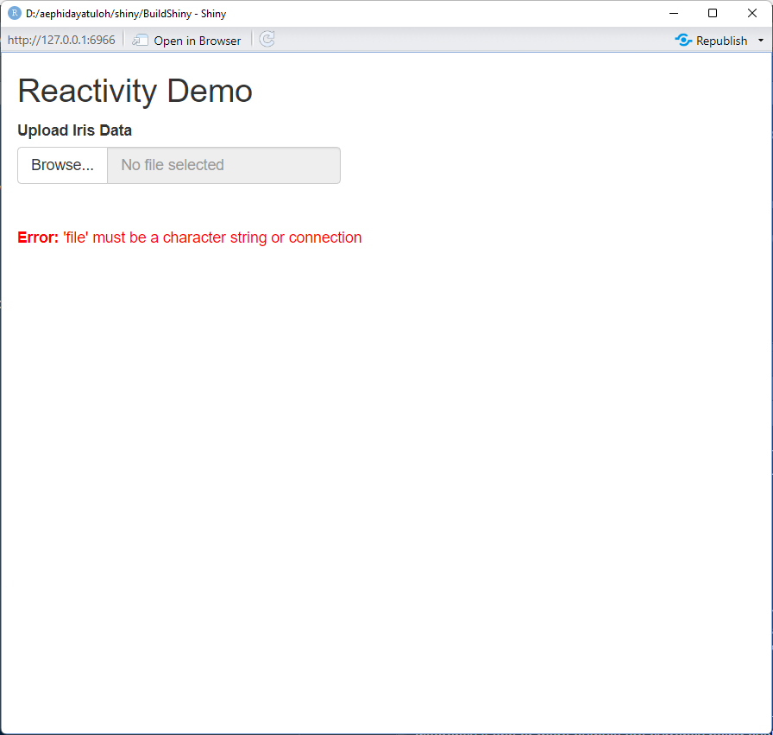
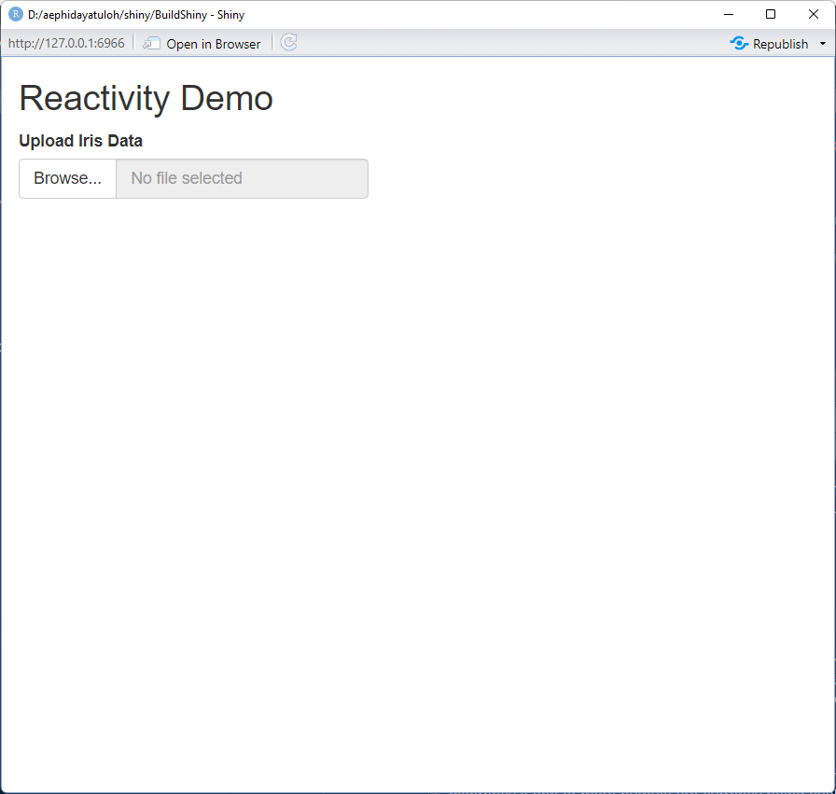

Slide 17
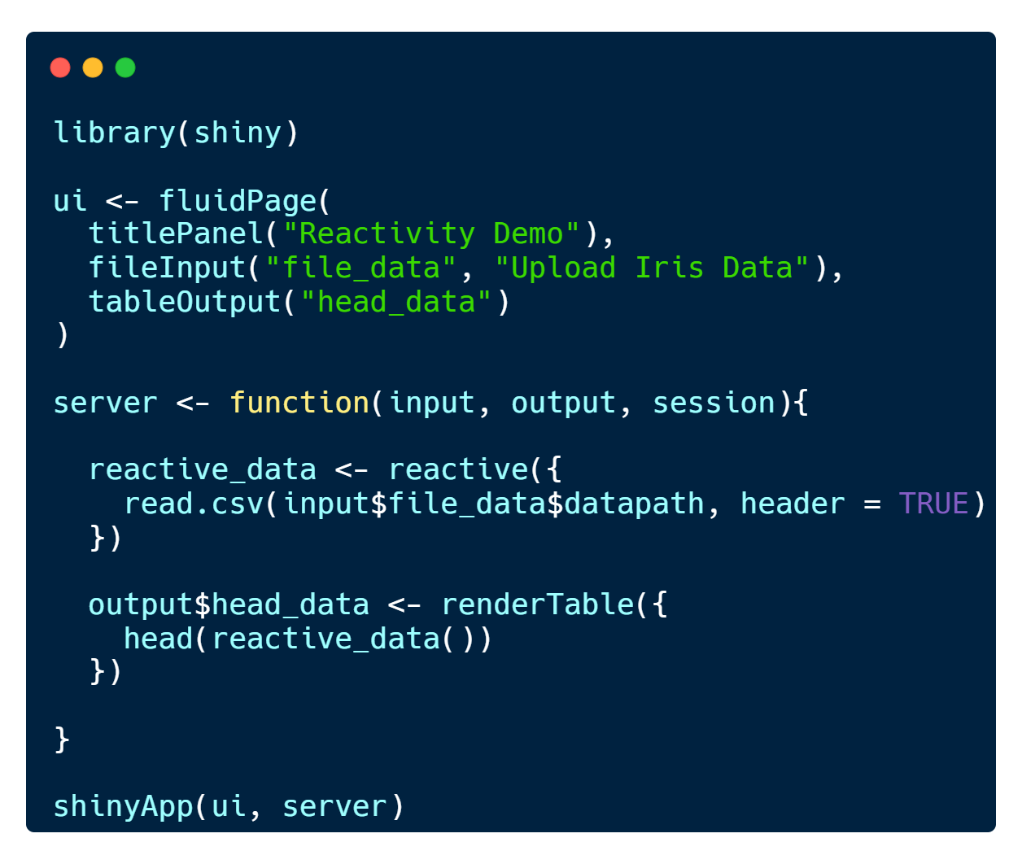
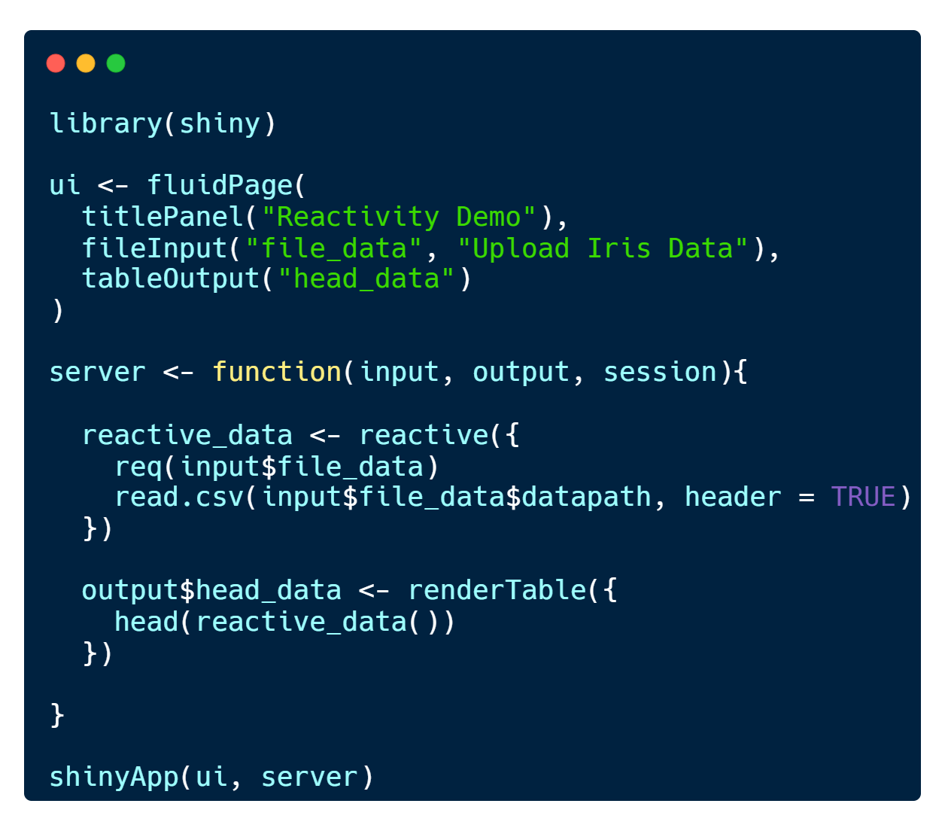
The req()
# server, inside reactive environment
req(…)

Slide 18
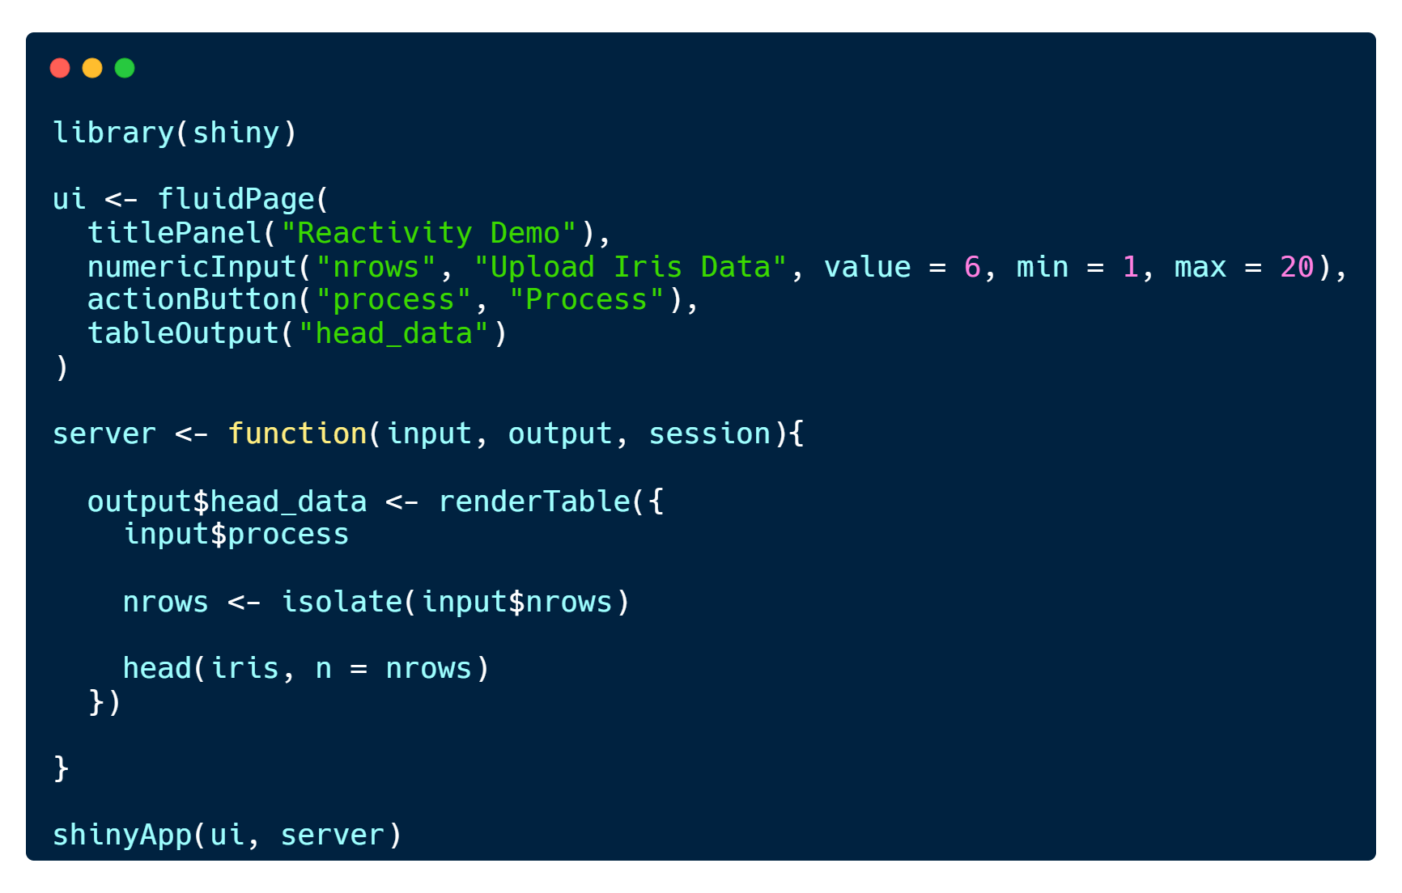
The isolate()
# server
isolate()

Slide 19
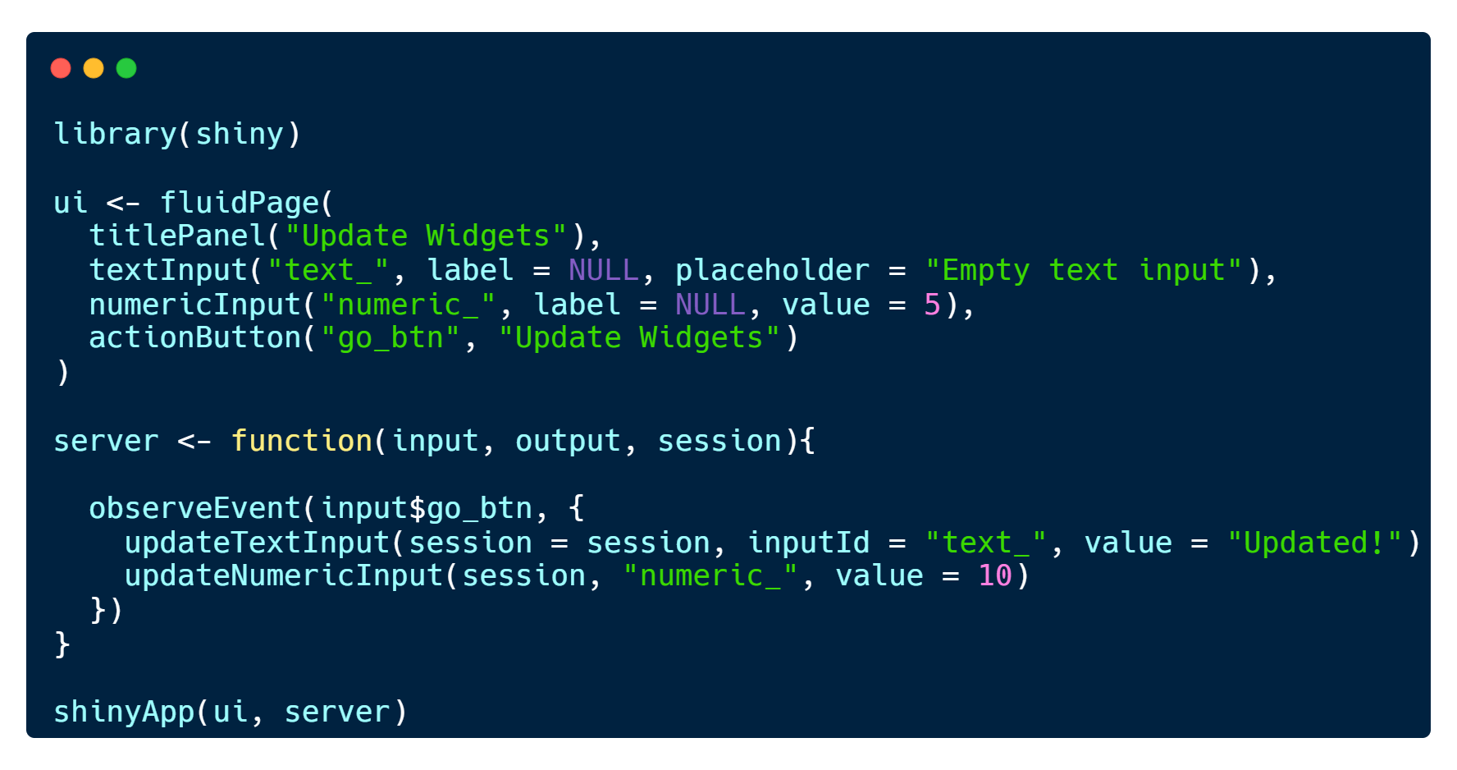
Update Widgets
# server
update<widgetFunction>(session, inputId, …)

